Slide 1

Capstone Project: Netflix Data
Visualize Netflix Data using Python
Completed By: Nicholas Budd

Slide 2
INTRODUCTION

Slide 3
Netflix Stock Profile
In this project, we will act as a data visualization developer at Yahoo Finance and will be helping the "Netflix Stock Profile" team visualize the Netflix stock data. In finance, a stock profile is a series of studies, visualizations, and analyses that dive into different aspects a publicly traded company's data. We will create visuals to show…
The distribution of the stock prices for the past year (2017)
Netflix's earnings and revenue in the last four quarters (2017)
The Actual vs. Estimated earnings per share for the four quarters in 2017
A comparison of the Netflix Stock price vs the Dow Jones Industrial Average price in 2017

Slide 4
FORMAT
VISUALIZATION
FINDINGS
CODE REVIEW
Visualization of the data into different charts.
These are presented in tandem with the findings.
Draw conclusions from the visualizations and data that was been given to us.
These are presented in tandem with the visualizations.
This section would not be included when given to a company to determine financial health but for the purpose of this presentation, we will include it for the purpose of fact checking.

Slide 5
STOCK PROFILE

Slide 6
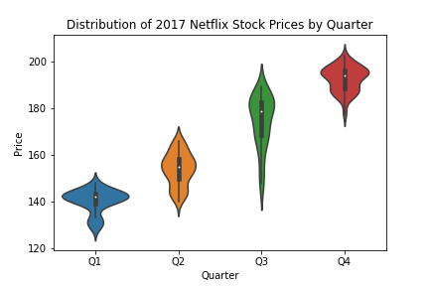
Stock Health
The Netflix stock saw a steady increase throughout the entire year.
Each Quarter occupying a higher and higher position (relative to the CSP)
Stock’s closing price saw between $130 -$200 for most of the year.
Low - $124.31
High - $204.38
While most Quarters were relatively steady (ranging between $30 or so), Quarter 3 saw the most volatility indicated by Wide Ranging Distribution.

Slide 7
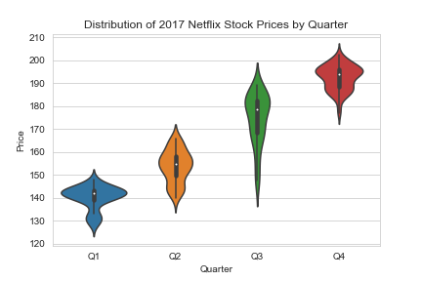
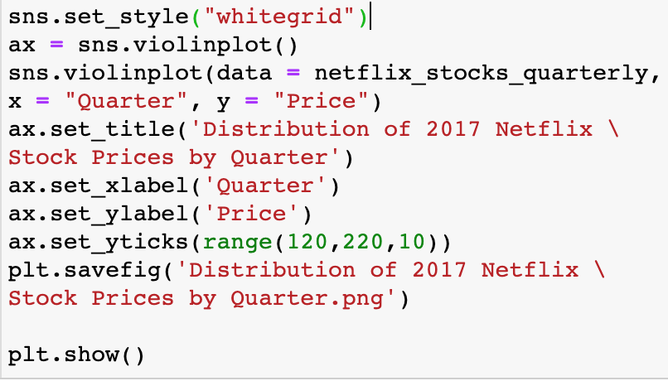
Stock Health : Code Review
We chose a violin plot to show the distribution of Stock Price by Quarter.
Main changes were to upping the number of y ticks for more clarity and creating the background of the “whitegrid” to add more depth to the graph.

Slide 8
EARNINGS VS. REVENUE

Slide 9
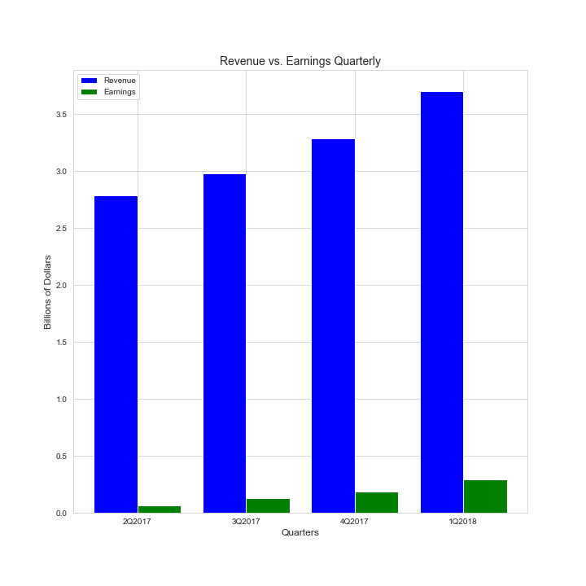
Earnings vs. Revenue
Each Quarter has seen great growth into the next quarter for both Earnings and Revenue. Based on the numbers below Netflix has not only gained great traction in growing Revenue but also became leaner in increasing profits.
The ratio for Earnings against Revenue is…
Q1 – 2.35%
Q2 – 4.35%
Q3 – 5.63%
Q4 – 7.84%
Revenue (in Billions) by Quarters…
Q1: 2.79 - Q2: 2.98 – Q3: 3.29 – Q4: 3.7
Earnings (in Billions) by Quarters…
Q1: 0.0656 - Q2: 0.1296 – Q3: 0.1855 – Q4: 0.2901

Slide 10
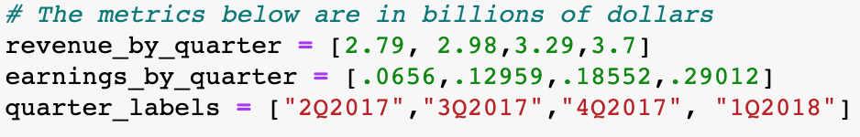
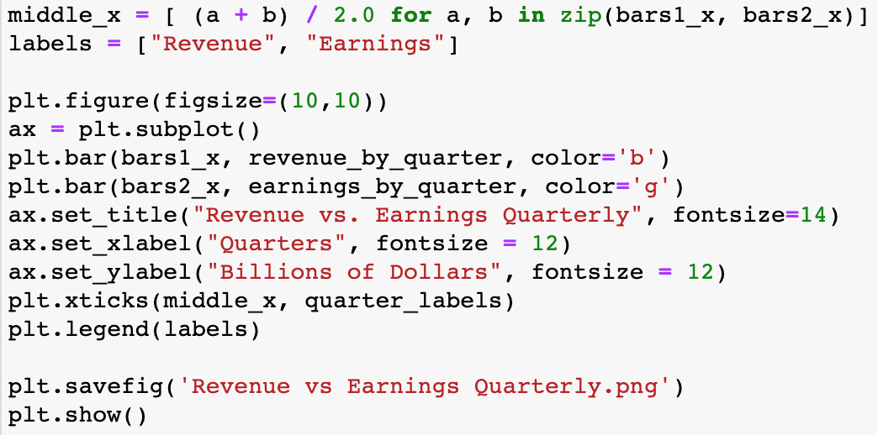
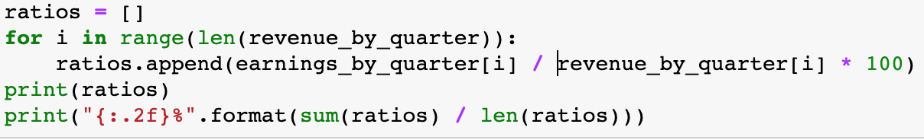
Earnings vs. Revenue - Code Review
Main changes that were made...
Retained the ”whitegrid” look from previous graph.
Changed color for earnings bar to green to represent profits.
Code to the left was used to find the ratio for Earnings against Revenue for each Quarter.

Slide 11
EPS REVIEW

Slide 12
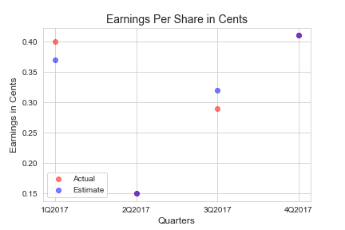
EPS REVIEW
Yahoo was accurate in estimating EPS for Netflix hitting on 2/4 Quarters plotted to the right (purple dots)
Q2
Q4
Netflix outperformed the estimate in Q1 but underperformed in Q3.

Slide 13
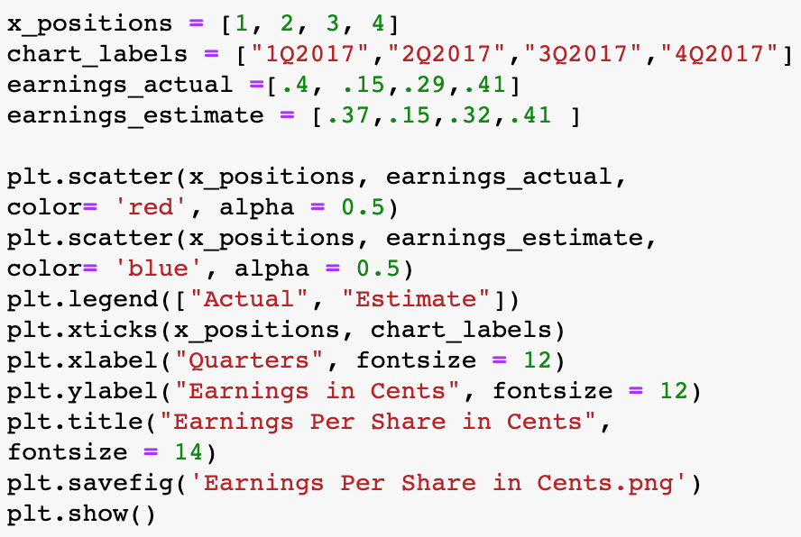
Earnings vs. Revenue - Code Review
Main changes that were made...
Retained the ”whitegrid” look from previous graph.
Changed color and transparency for actual earnings and earnings estimate in case there was overlap.

Slide 14
EPS REVIEW

Slide 15
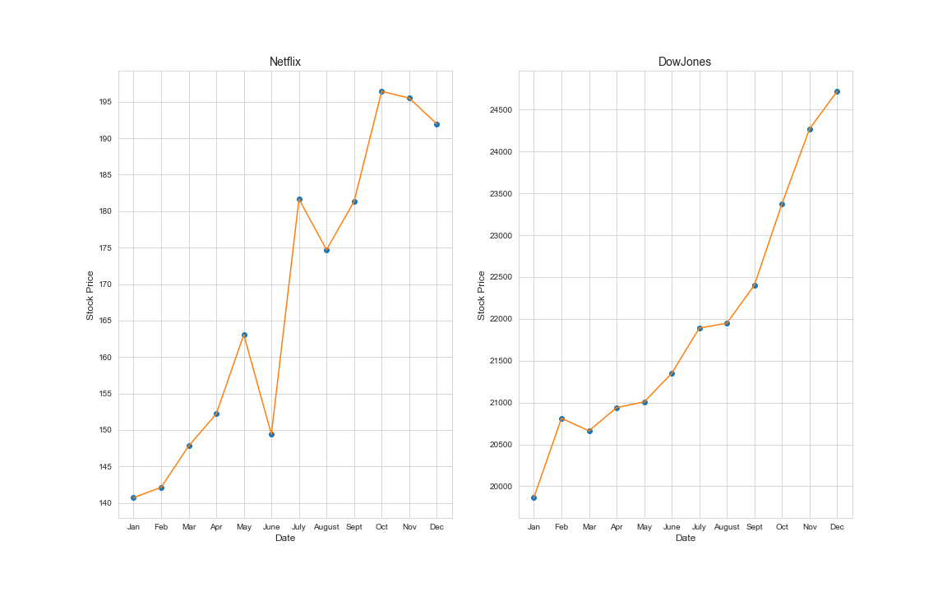
NFLX vs. DJI

Slide 16
NFLX vs. DJI
Netflix and Dow Jones both saw significant increases in Stock Price over the year 2017.
Netflix saw a lot more volatility in stock price compared to that of Dow Jones.
The percent increase from January to December are…
Netflix – 42.53% increase
Dow Jones – 23.60% increase

Slide 17
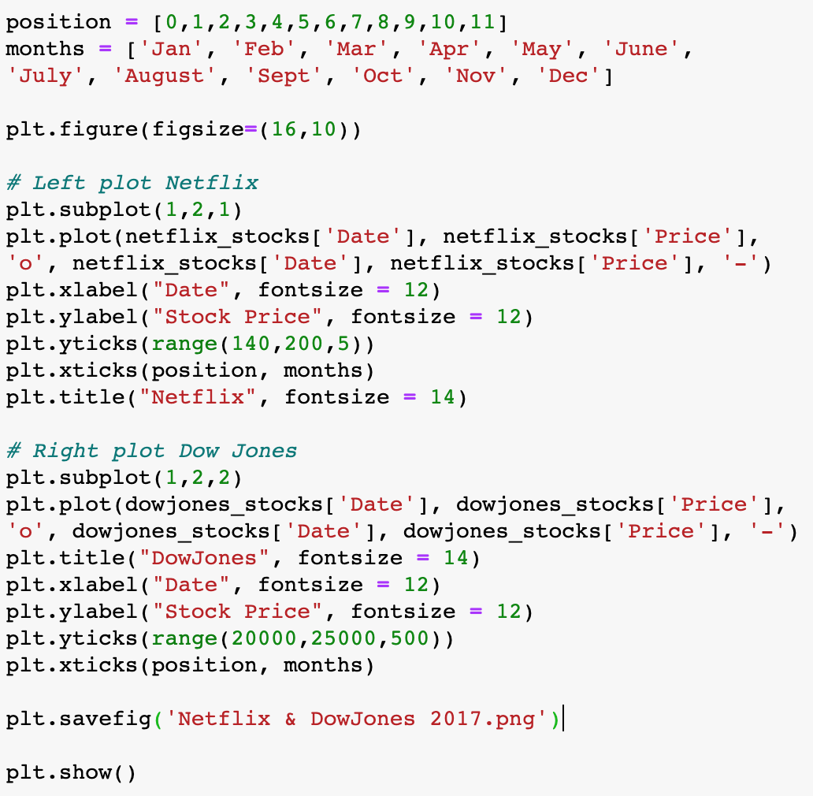
NFLX vs. DJI – Code Review
Main changes that were made...
Retained the ”whitegrid” look from previous graph.
Created more y-tick marks to show more of a range.
Created a list of months to create the x-tick marks.

